Slide 1
Beginning to explore data
Dr. Asma Ahmad

Slide 2
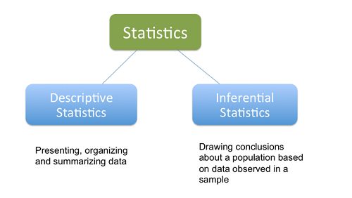
Stats for Data Science

Slide 3
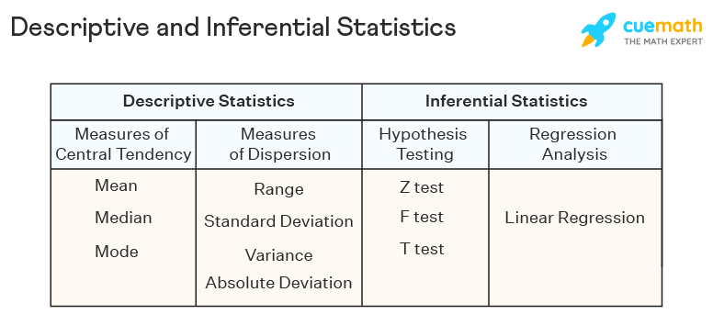
Difference

Slide 4
Lets learn to Measures the Central Tendency
Lets talk about summary statistics: Mean, Median, Mode, Range, Standard
Deviation, Variance, Min, Max etc

Slide 5
Be Careful
Measurement error or missing data may mean that if we treated a population as complete that we may have inefficient estimates.
It depends on the type of data and project.

Slide 6
Measures of Central Tendency
These measures tap into the average distribution of a set of scores or values in the data.
Mean
Median
Mode

Slide 7
Problem of being “mean”
The main problem associated with the mean value of some data is that it is sensitive to outliers.
Example, the average weight of political science professors might be affected if there was one in the department that weighed 600 pounds.

Slide 8
Donut-Eating Professors
Professor | Weight |  | Weight
Schmuggles | 165 |  | 165
Bopsey | 213 |  | 213
Pallitto | 189 |  | 410
Homer | 187 |  | 610
Schnickerson | 165 |  | 165
Levin | 148 |  | 148
Honkey-Doorey | 251 |  | 251
Zingers | 308 |  | 308
Boehmer | 151 |  | 151
Queenie | 132 |  | 132
Googles-Boop | 199 |  | 199
Calzone | 227 |  | 227
 | 194.6 |  | 248.3

Slide 9
The Median
Because the mean average can be sensitive to extreme values, the median is sometimes useful and more accurate.
The median is simply the middle value among some scores of a variable. (no standard formula for its computation)

Slide 10
What is the Median?
Professor | Weight
Schmuggles | 165
Bopsey | 213
Pallitto | 189
Homer | 187
Schnickerson | 165
Levin | 148
Honkey-Doorey | 251
Zingers | 308
Boehmer | 151
Queenie | 132
Googles-Boop | 199
Calzone | 227
 | 194.6
Weight
132
148
151
165
165
187
189
199
213
227
251
308
Rank order and choose middle value.
If even then average between two in the middle

Slide 11
Percentiles
If we know the median, then we can go up or down and rank the data as being above or below certain thresholds.
You may be familiar with standardized tests. 90th percentile, your score was higher than 90% of the rest of the sample.

Slide 12
The Mode
The most frequent response or value for a variable.
Multiple modes are possible: bimodal or multimodal.

Slide 13
Figuring the Mode
Professor | Weight
Schmuggles | 165
Bopsey | 213
Pallitto | 189
Homer | 187
Schnickerson | 165
Levin | 148
Honkey-Doorey | 251
Zingers | 308
Boehmer | 151
Queenie | 132
Googles-Boop | 199
Calzone | 227
What is the mode?
Answer: 165
Important descriptive information that may help inform your research and diagnose problems like lack of variability.

Slide 14
Measures of Dispersion
Measures of dispersion tell us about variability in the data. Also univariate.
Basic question: how much do values differ for a variable from the min to max, and distance among scores in between. We use:
Range
Standard Deviation
Variance

Slide 15
Why Dispersion is important
Remember that we said in order to glean information from data, i.e. to make an inference, we need to see variability in our variables.
Measures of dispersion give us information about how much our variables vary from the mean, because if they don’t it makes it difficult infer anything from the data. Dispersion is also known as the spread or range of variability.

Slide 16
The Range
r = h – l
Where h is high and l is low
In other words, the range gives us the value between the minimum and maximum values of a variable.
Understanding this statistic is important in understanding your data, especially for management and diagnostic purposes.

Slide 17
The Standard Deviation
A standardized measure of distance from the mean.
Very useful and something you do read about when making predictions or other statements about the data.

Slide 18
Formula for Standard Deviation
S =
=square root
∑=sum (sigma)
X=score for each point in data
_
X=mean of scores for the variable
n=sample size (number of observations or cases

Slide 19
We can see that the Standard Deviation equals 165.2 pounds. The weight of Zinger is still likely skewing this calculation (indirectly through the mean).

Slide 20
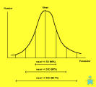
What is the Distribution?
Gives us a picture of the variability and central tendency.
Can also show the amount of skewness and Kurtosis.

Slide 21
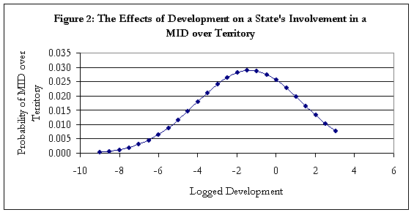
Graphing Data: Types

Slide 22
Creating Frequencies
We create frequencies by sorting data by value or category and then summing the cases that fall into those values.
How often do certain scores occur? This is a basic descriptive data question.

Slide 23
Ranking of Donut-eating Profs. (most to least)
Zingers | 308
Honkey-Doorey | 251
Calzone | 227
Bopsey | 213
Googles-boop | 199
Pallitto | 189
Homer | 187
Schnickerson | 165
Smuggle | 165
Boehmer | 151
Levin | 148
Queeny | 132

Slide 24
Here we have placed the Professors into weight classes and depict with a histogram in columns.

Slide 25
Here it is another histogram depicted as a bar graph.

Slide 26
Pie Charts:

Slide 27
Actually, why not use a donut graph. Duh!
See Excel for other options!!!!

Slide 28
Line Graphs: A Time Series

Slide 29
Scatter Plot (Two variable)

Slide 30
Shape of the Distribution
Symmetrical (mean is about equal to median)
Skewed
Negatively (example: years of education)
mean < median
Positively (example: income)
mean > median
Bimodal (two distinct modes)
Multi-modal (more than 2 distinct modes)

